Slide 1



Dental Apprenticeships, Training and CPD

Slide 2




99.6%
20+
Pass rate
Leading dental group partners
140+
30
Hours online CPD modules
Years of industry experience

Slide 3




Who are we?
UK’s leading provider of dental apprenticeships, training & recruitment services.
Deep-rooted expertise in the sector, combining a flexible and learner-focused approach.
Investing in
the latest technology, to ensure a smooth delivery for our learners and employers.
We have the highest QAR in the industry and a 99.6% pass rate. We are leaders on quality.

Slide 4

Why choose Tempdent?
of learners are satisfied with their Tutor Assessor.
of learners feel their apprenticeship is relevant to their job role.
90%
93%
and rated 4.9* on TrustPilot and awarded ‘Good’ with Ofsted.
We’re rated 5* on Google…

Slide 5
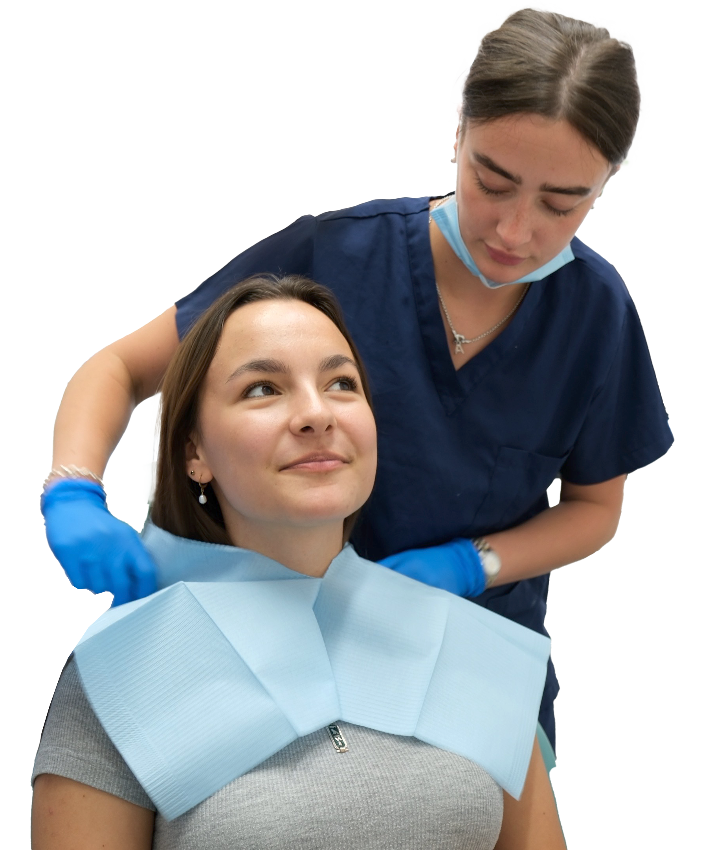








Benefits of hiring an apprentice
in your dental practice
Improved staff retention
Cost-effective staffing
Increased productivity
Financial incentives
Positive community
impact
Tailored training
Government funded apprenticeships
Fresh perspectives

Slide 6

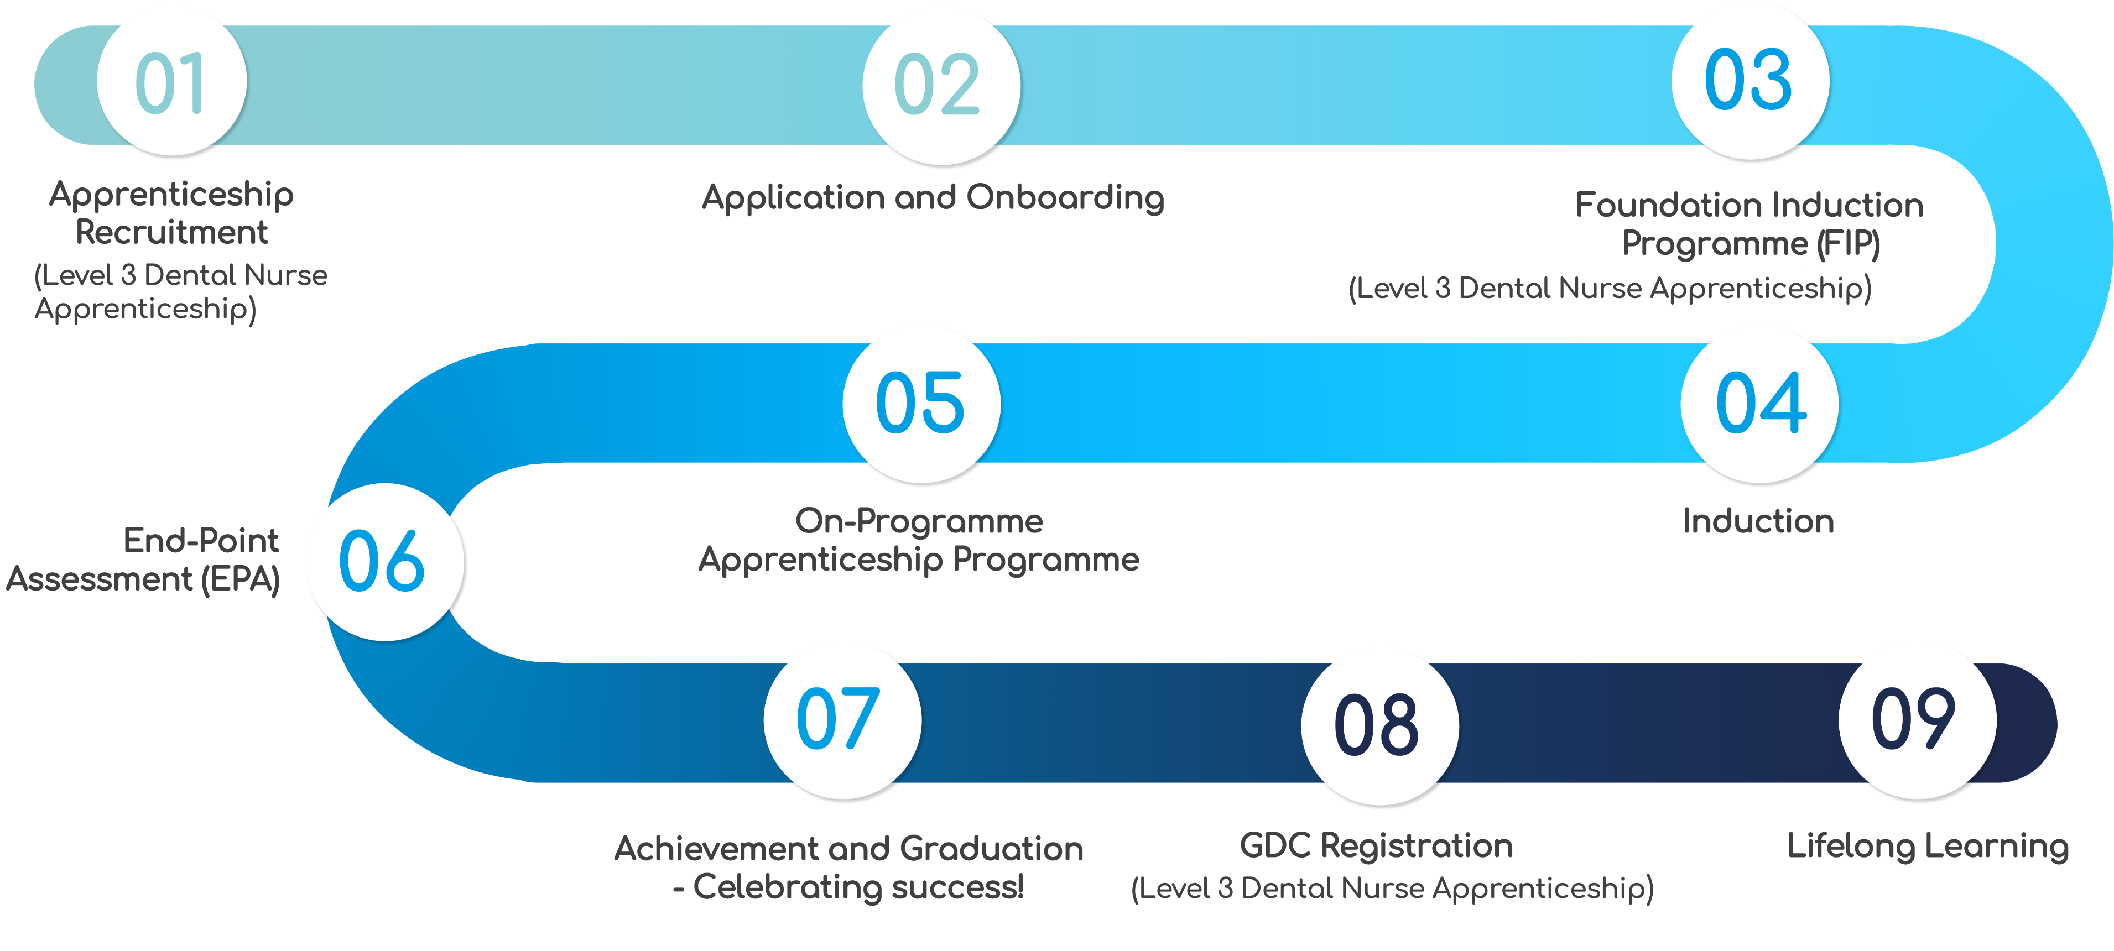
The Apprenticeship Journey
(100% EPA success rate)

Slide 7
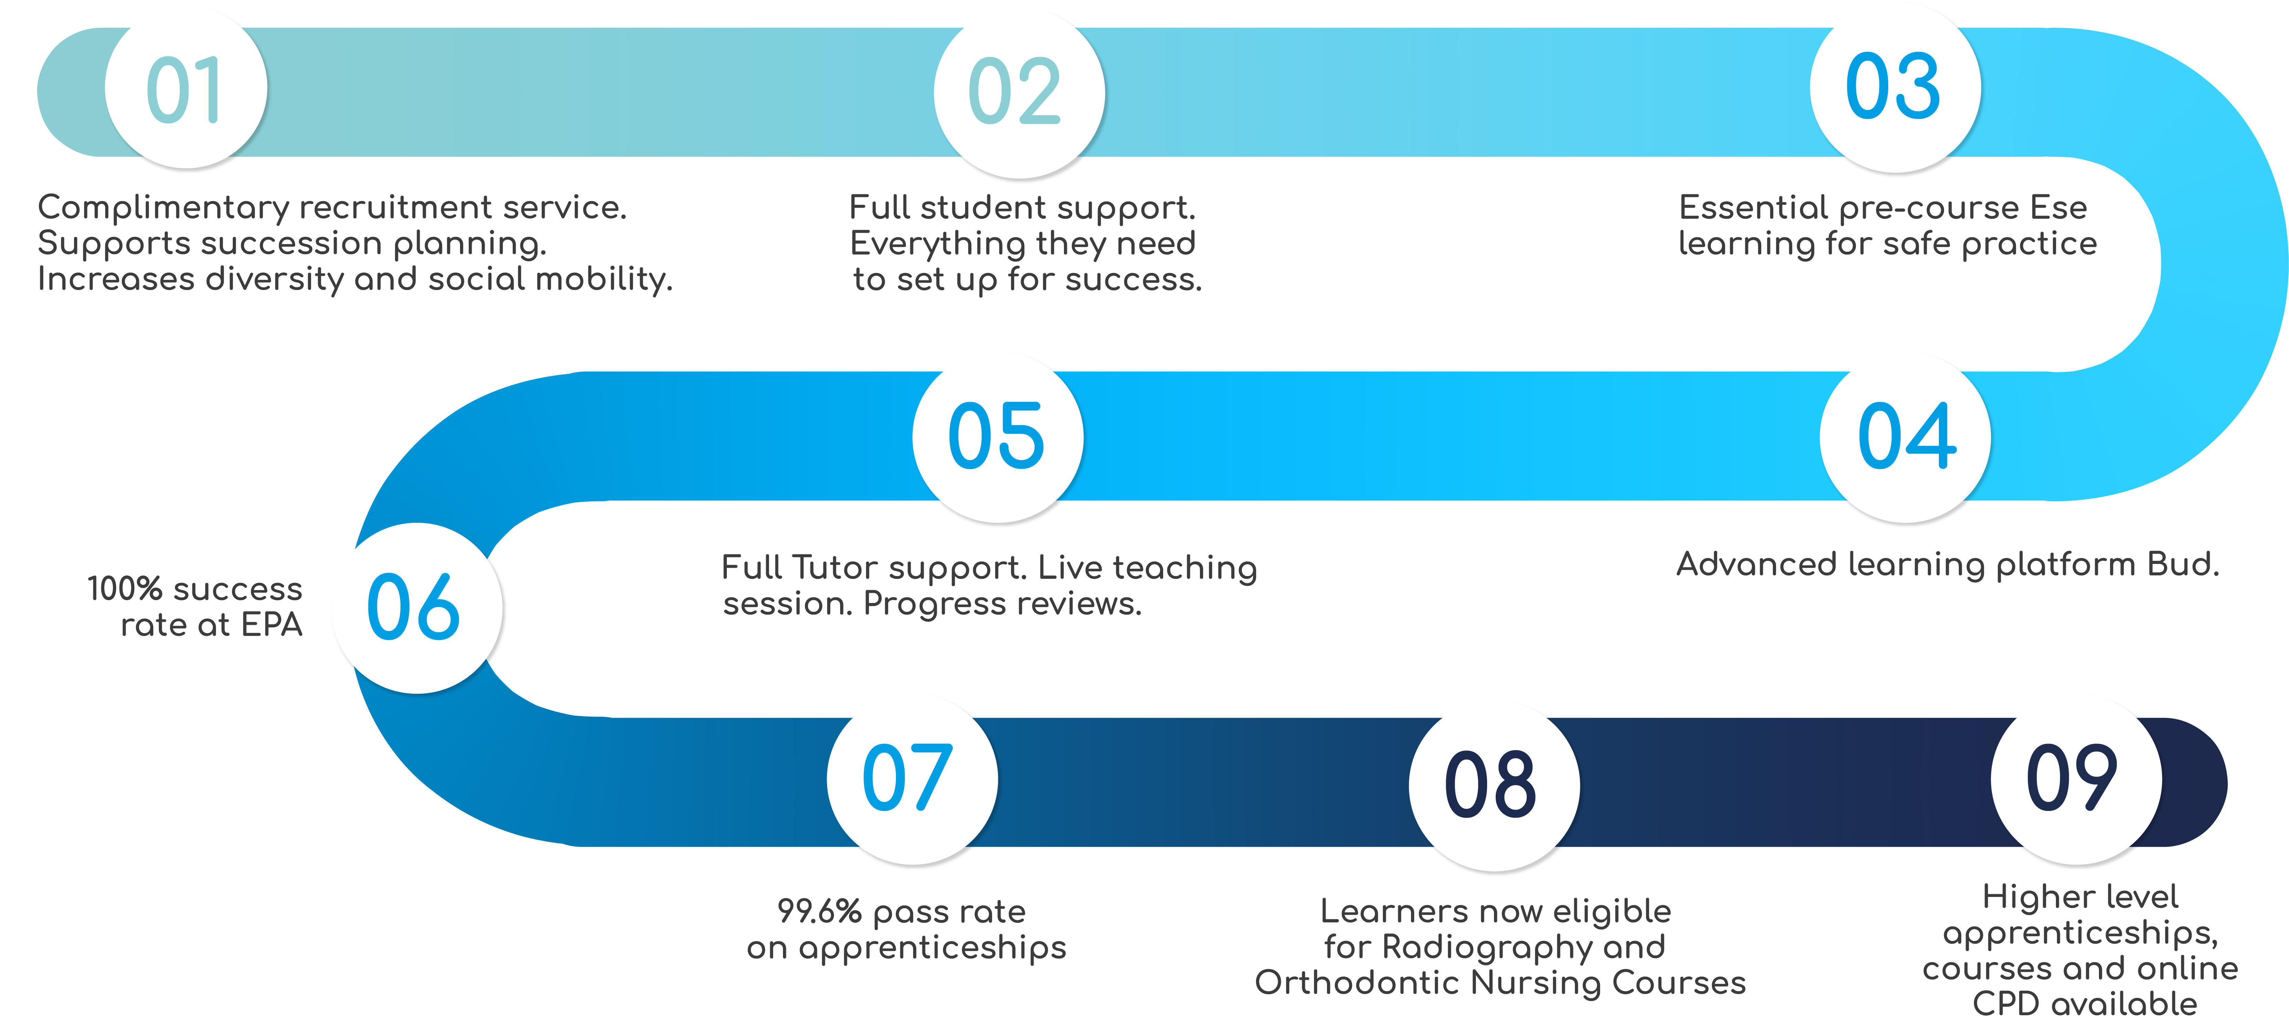
Key USPs for each stage

Slide 8
Dental Nurse Apprenticeship
Level 3

Slide 9




Dental Nurse Apprenticeship Level 3
This apprenticeship includes:
City & Guilds
Level 3 Dental Nursing Practitioner Diploma
Functional Skills
in English & Maths
(unless exempt)
Integrated
End-Point
Assessment
Knowledge, skills and behaviours from the Dental Nurse (GDC 2023) Apprenticeship Standards

Slide 10

Dental Nurse Apprenticeship Level 3
This apprenticeship is delivered nationwide through a combination
of eLearning modules and interactive workshops.
Apprentices are assessed through portfolio building, observations in practice and completing exams, meaning no ‘college days’ are required away from
your dental practice.
Apprentices also have the choice of multiple online workshops each day, meaning it’s easy to fit them in
around their day-to-day role.

Slide 11
Dental Nurse Apprenticeship Level 3
Entry Requirements
Applicants with Maths and English GCSE (A – C / 4 – 9) or Key/Functional Skills Level 2 will be exempt from Functional Skills.
Apprentices aged 19 and over, English & Maths Functional Skills is no longer required.
All apprentices must complete the full off-the-job training hours (OTJ) required by the apprenticeship standard within paid working time.
This apprenticeship commences quarterly
January, April
July and October

Slide 12
Dental Nurse Apprenticeship Level 3
Course Syllabus
Module 1 – Introduction to Dental Nursing
Module 2 - Health and Safety in Dental Settings
Module 3 – Infection Control and Prevention
Module 4 – First Aid and Medical Emergency Response
Module 5 – Communication and Patient Care
Module 6 – Dental and Regional Anatomy
Module 7 – Radiography and Imaging Techniques
Module 8 – Periodontal Disease and Caries Management
Module 9 – Endodontic Procedures Support
Module 10 – Extractions and Minor Oral Surgery
Module 11 – Prosthetic Treatment Support
Module 12 – Oral and Physical Health Education
Module 13 – Delivering Oral Health Information
Module 14 – Professional Development and Appraisal
Module 15 – Professional Competency and Career Progression

Slide 13


How will your practice benefit
from this apprenticeship?
Committed Talent
Bring in motivated apprentices who learn your practice’s way of working while developing loyal team members who understand your setup inside out.
Lower Recruitment Costs
Complimentary recruitment service matching candidates to your needs.
Financial Benefits
£1000 incentive for each 16 to 18 year old apprentice hire. Employers don’t pay NI for apprentices under 25, saving 15% of annual salary.

Slide 14

Oral Health Practitioner Apprenticeship Level 4

Slide 15
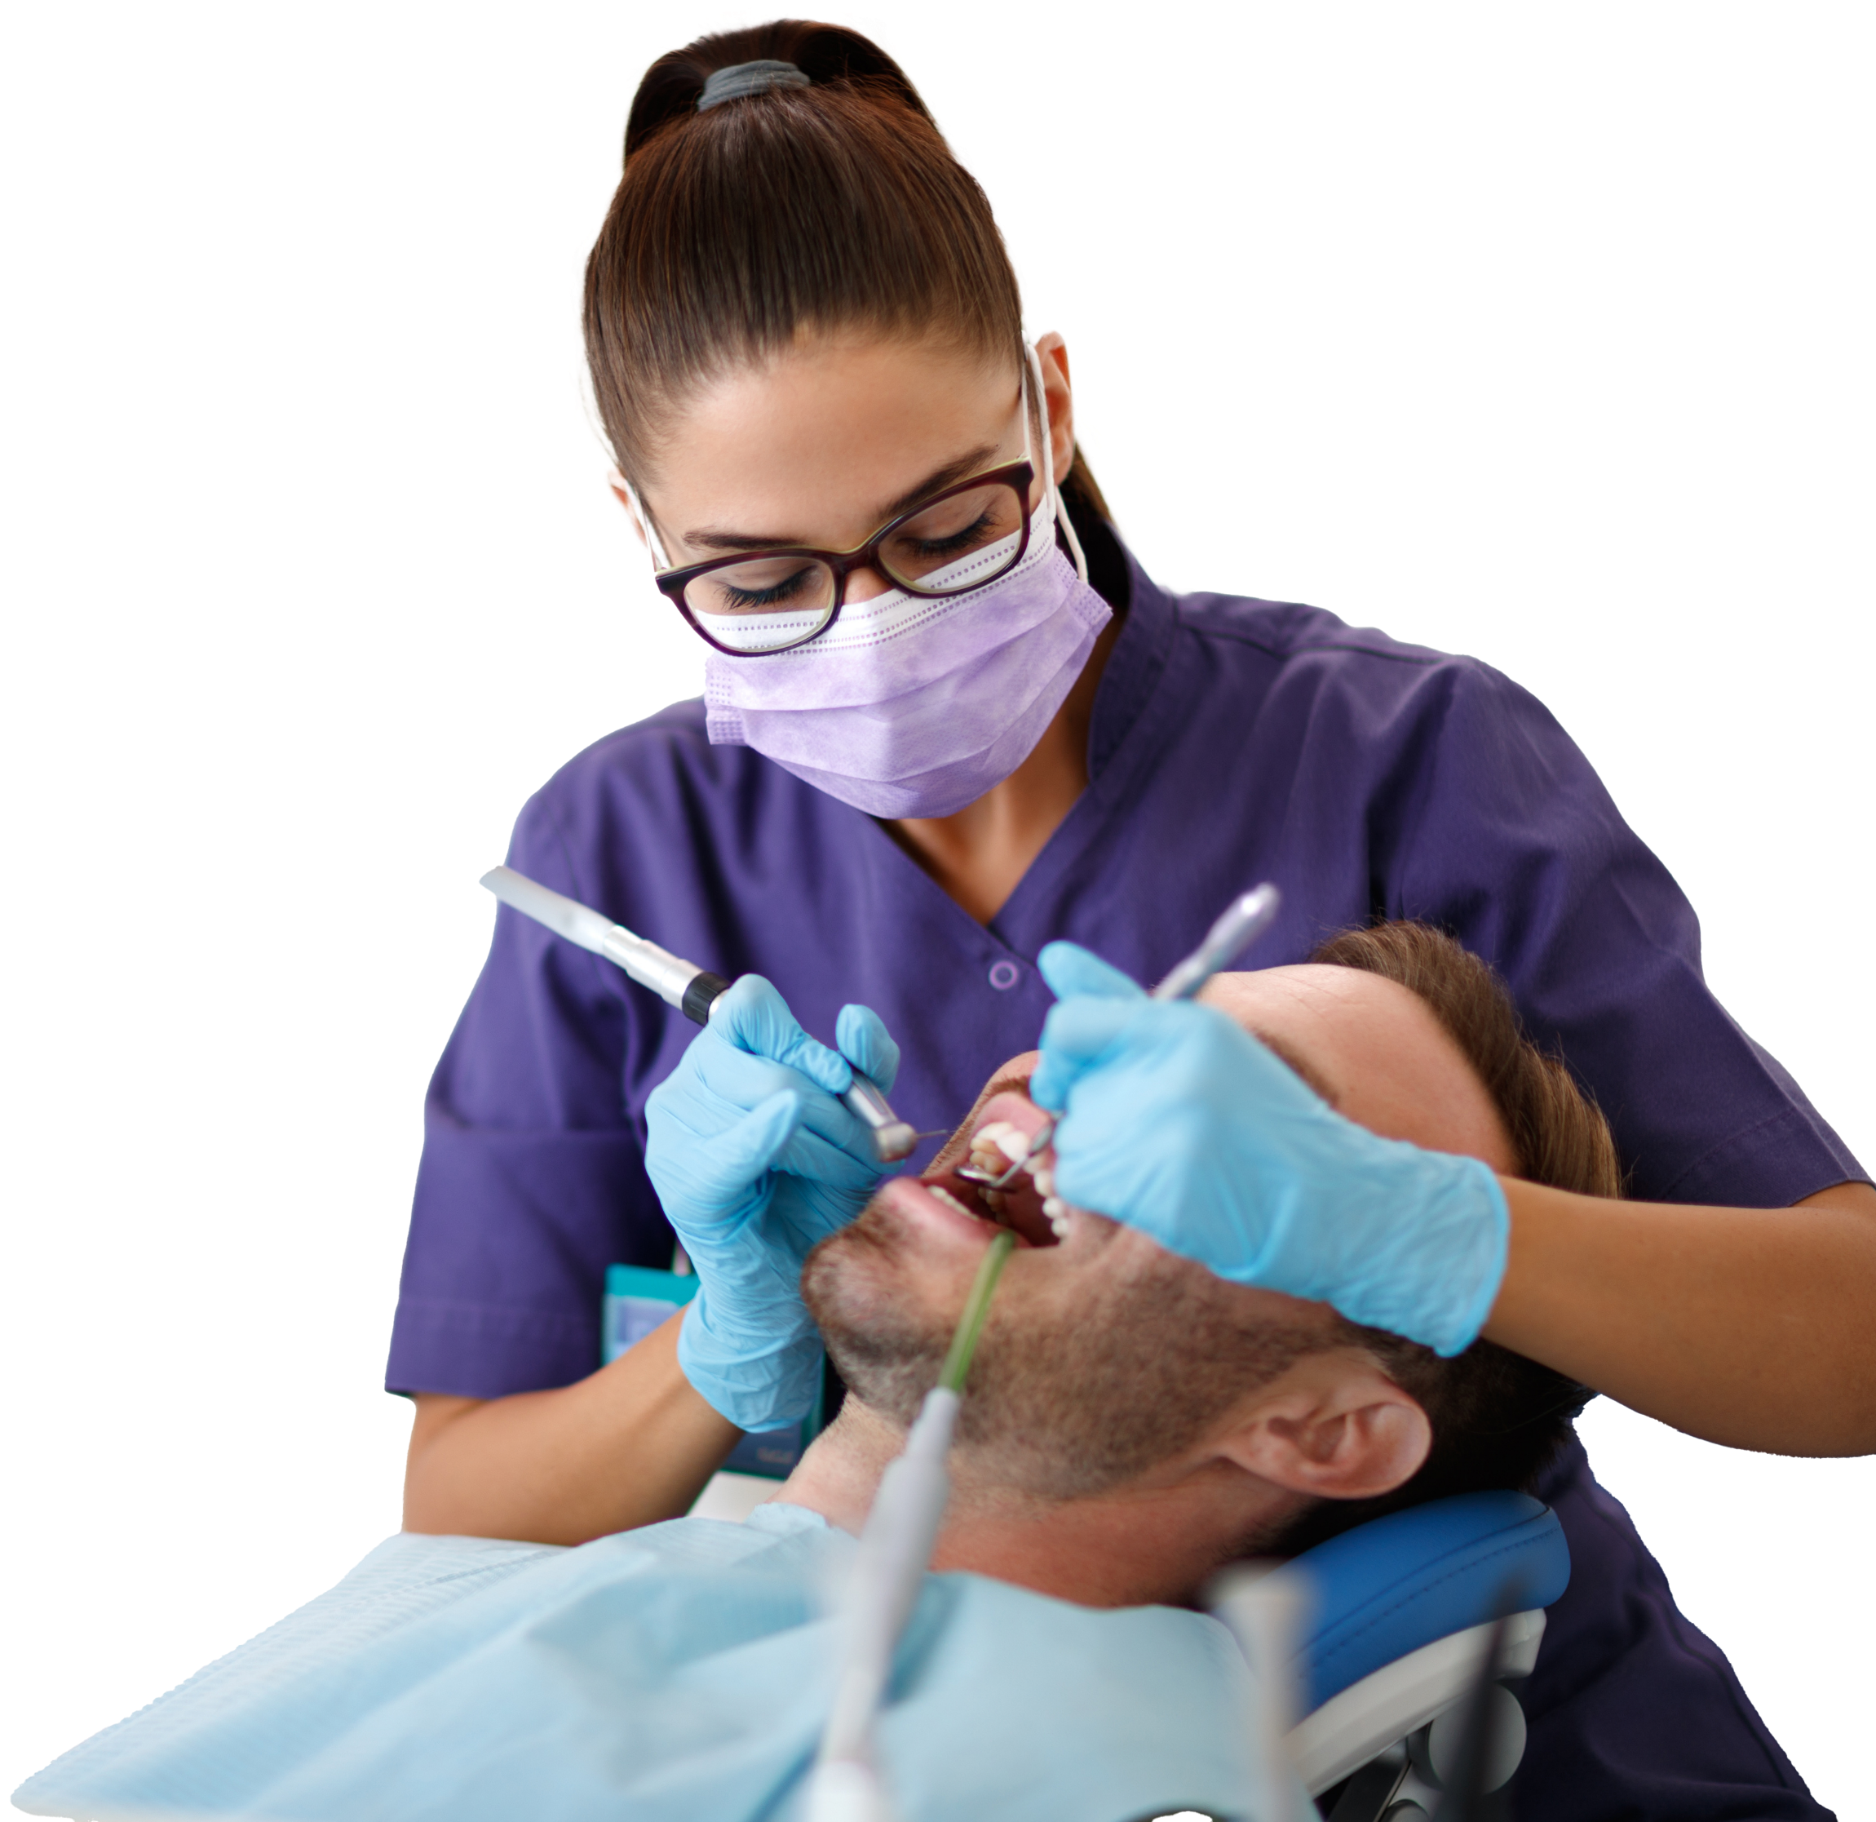
Oral Health Practitioner Level 4
The Level 4 Oral Health Practitioner equips apprentices with the clinical and communication skills to deliver preventative care, carry out oral health and general health assessments
14 month programme
Qualified OHPs can be paid for the work that they deliver in the community through flexible commissioning, making them a cost effective and impactful addition to your team.
This apprenticeship is a recognised pathway to further Dental Hygienist qualifications.

Slide 16

Oral Health Practitioner Level 4
This apprenticeship includes:
Oral Health Practitioner Apprenticeship Standard.
Functional Skills
​in English and Maths​ (unless exempt).
End Point-Assessment:
MCQ exam, observation and professional discussion.
Four in-person skills labs where apprentices undergo practical training.

Slide 17
Oral Health Practitioner
Apprenticeship Level 4 Entry Requirements
Candidates must be GDC-registered Dental Nurses or appropriate GDC-registered dental care professionals, working within a dental practice.
Applicants with Level 2 (GCSE A-C/4-9) are exempt, others may need to complete Functional Skills.
All apprentices will complete onboarding checks to identify if additional support is needed.
Bupa has an internal application process to complete for anyone interested in the programme
This apprenticeship commences quarterly
January and July

Slide 18

In-Person Skills Labs
We provide four skills labs throughout the course, where apprentices will undergo practical training in groups, at purpose built dental hospitals
or labs across the country.
During the skills labs, apprentices will learn practical elements including:
Patient positioning in dental chair
Measuring & recording plaque indices
Taking impressions& intra-oral scanning
Intra &
extra oral photography
Finger-prick blood tests & blood pressure
Applying topical fluoride

Slide 19
Oral Health Practitioner
Apprenticeship Level 4 Course Syllabus
Module 1 – The principles of health improvement, and how to promote change
Module 2 - Supporting behaviour change to improve an individual’s health
Module 3 – How to deliver an NHS Health Check and assessing risk of cardiovascular disease
Module 4 – Professional, ethical and legal requirements for Oral Health Practitioners
Module 5 – Health inequalities and adapting procedures
Module 6 – Conducting motivational consultations
Module 8 – Anatomy, physiology and nutrition for Oral Health Practitioners
Module 9 – Understanding clinical practice for Oral Health Practitioners
Module 10 – Carry out Oral Health Practitioner preventative practice
Module 11 – Understand preventative practice for Oral Health Practitioners
Module 12 – Understanding the role of the Oral Health Practitioner

Slide 20





How will your practice benefit
from this apprenticeship?
Improved clinical efficiency
OHPs carry out oral hygiene instruction and preventative measures.
Enables more efficient use of clinical time for complex procedures.
Better patient access and community reach
OHPs can work in schools, care homes, and local community settings.
Increase new patient flow to your practice and improve access to care.
Cost-effective workforce development
Support staff development with a clear structured career
progression.
Retain skilled staff while expanding capabilities affordably, reducing recruitment costs.
Flexible commissioning
Qualified OHPs can be paid for the work that they deliver in the community through flexible commissioning, making them a cost effective
and impactful addition to
your team.
ROI
OHPs deliver oral health education within the wider community and are able to refer individuals back to your practice, increasing your patient pool.

Slide 21

Dental Reception Excellence Apprenticeship Level 2
NEW

Slide 22

Dental Reception Excellence Level 2
Based on extensive consultation with dental employers and sector experts, the programme develops confident, capable Dental Receptionists who can support patient care, navigate clinical pathways and drive measurable benefits for practices.
12 month programme
Learners gain an understanding of key organisational policies, relevant dental legislation, and essential internal procedures. Completion of the programme also develops core dental‑specific skills needed to confidently perform the role of a Dental Receptionist. These include patient communication and foundational dental knowledge.

Slide 23
Dental Reception Excellence
Level 2 Entry Requirements
Functional Skills is mandatory for all apprentices aged 16-18 unless exempt. For apprentices aged 19+, there is the option to opt out of the Functional Skills assessments, provided their employer agrees.
Enrol an apprentice on to our very first June 2026 cohort

Slide 24
Dental Reception Excellence Level 2 Learning outcomes
Learners will gain the following learning outcomes:
An understanding of organisational policies
Awareness of internal procedures
Understanding of complaints processes
Understanding of digital media policies
Completion of this programme will also develop the following key, dental‑specific skills that enable learners to confidently perform the role of a Dental Receptionist within your practice:
Delivering an outstanding patient experience
Handling challenging conversations and complaints.
Improving customer experience by managing expectations with clarity and confidence.
Professional body language, call handling and email etiquette.
More dental skills on the next page

Slide 25
Dental Reception Excellence Level 2 Learning outcomes
Confidently managing the dental patient journey
Awareness of dental terminology and treatment pathways.
Understanding referrals and clinical roles.
Awareness of NHS, private and mixed practice models.
Operating with professionalism, compliance and confidence
Workplace maturity and presentation.
Confidentiality, consent and information governance.
Effective upward communication with clinicians/managers.
Commercial awareness (Ethical influencing)
Protecting chair time utilisation and managing cancellations.
Reinforcing clinician recommendations.
Presenting membership plans, private options and elective treatments.
Driving measurable benefits for practices.
Promoting products, services, customer care and offering patient choice.
Building confidence & resilience in a fast-paced reception environment
Managing patient pressure and emotional demands.
Strategies for resilience in fast-paced reception environments.
Mental health awareness within the wider practice environment.

Slide 26
How will your practice benefit
from this apprenticeship?
Customer experience
Receptionists play a vital role, managing patient journeys, helping them feel informed, and creating that all-important first and last impression.
Commercially minded
This programme was co‑designed with dental employers who identified key gaps in dental knowledge and commercial awareness. The apprenticeship directly addresses these areas to enhance commercial performance.
Staff retention
Bring in a motivated apprentice who learns your practice’s way of workin,g while developing loyal team members who understand your setup inside out.

Slide 27

National Diploma in Dental Nursing

Slide 28
Pursue excellence in Dental Nursing
The National Diploma in Dental Nursing is a 12 month programme. Recognised as a General Dental Council (GDC) qualification that builds strong foundations in dental care, patient management, and
clinical skills.
Entry requirements
No formal qualifications are required however learners will need to pass a literacy and numeracy assessment in order to enrol.
Need to be working a minimum of 16 hours per week
This apprenticeship includes:
NEBDN National Diploma
in Dental Nursing
Formative workplace assessment (with written and practical components)
Record of experience
NEW enrol every month!

Slide 29
National Diploma in Dental Nursing
Course Syllabus
Health & safety and infection
control in the workplace
Medical emergencies
Dental radiography
Legislation and ethics
Dental and general anatomy
Dental disease – cause, diagnosis and prevention
Dental check-ups, treatment
planning and actual treatments
Patient care and management
Dental drugs, materials instruments and equipment

Slide 30



How will your practice benefit
from this course?
Flexible learning
Fortnightly online classes (either on a Saturday or weekday evening) with experienced GDC-registered tutors.
Practical & Exam-based Assessment
Learners complete a Record of Experience portfolio. Course ends with a written exam and invited to the Objective Structured Clinical Examinations (OSCE) practical/oral exams.
Accredited Qualification
Awarded by National Examining Board for Dental Nurses (NEBDN), delivered through Tempdent’s accredited training centre.

Slide 31

Certificate in Dental Radiography
100%
Pass Rate

Slide 32

Certificate in Dental Radiography
Gain essential expertise in dental radiography
with Tempdent’s Dental Radiography Certificate.
Empowers learners to confidently
undertake radiography imagery.
Interpret radiographic images for
diagnostic quality.
Contribute to superior diagnostic outcomes in dental settings, all supported by cutting-edge technology and interactive learning modules.
Certificated by the College of Radiographers
who are the professional body for the diagnostic imaging and radiotherapy workforce in the UK.
Course fee:
£650 + VAT
(including exam fees)
Duration:
9 months

Slide 33


Certificate in Dental Radiography
Course Structure
Learners will build a Record of Competence (ROC), under supervision of a radiographer qualified practitioner, to undertake the following images:
7
Dental panoramics
In addition, learners will also complete:
4
Supplementary projects
7
Pairs of bitewings
7
Formative assessments
6
Posterior and six anterior periapicals
Continuous knowledge assessments (including mock exams)
Technical exam with 50 multiple choice questions

Slide 34
Certificate in Dental Radiography
Entry Requirements
Applicants must be GDC registered.
Dental practice must support learners in taking patient radiographs and provide supervision.
Supervision can be by a suitably qualified registrant (e.g. Dentist, Therapist, Hygienist, Nurse, or qualified medical professional).
This programme commences quarterly
January, April
July and October

Slide 35

Certificate in Dental Radiography
Learning outcomes
On completion of this course, learners will:
  Understand patient care & safety – patient considerations, ​knowledge of risks, and radiation protection.
  Use, maintain and complete clinical audits
  of equipment and practice.
  Understand professional standards –
  team roles, responsibilities & legislation.
  Understand how to take a variety of images using a variety of techniques.

Slide 36

Orthodontic Nursing Certificate
100%
Pass Rate

Slide 37



Certificate in Orthodontic Nursing
Course overview
Course Fees
£850 + VAT
Exam fee: £210
Deposit: £300
(plus exam fee on booking)
Learn from
experts
Industry-led
teaching and
hands-on training
Build
confidence
Advanced orthodontic
nursing knowledge
& skills
Recognised qualification
Awarded by National Examining
Board for
Dental Nurses

Slide 38



Certificate in Orthodontic Nursing
Course structure
Assessments:
Written exam
Record of Competence
Case studies
Directly Observed Clinical Skills
Delivery:
Course runs for
12 months
Online webinars
(One Saturday per month)
e-Learning
Entry:
Applicant musts be GDC registered
Course commences bi-annually:
April & October

Slide 39
Certificate in Orthodontic Nursing Learning Outcomes
Anatomical structures relative to orthodontics
Classification of malocclusion
Orthodontic treatment
and orthodontic appliances
Orthodontic records
Cross infection in orthodontics
Interdisciplinary care
Laboratory skills
Oral health in relation to
the care and management
of appliances
Orthodontic stock control
Medico-legal aspects of
orthodontics

Slide 40

Fluoride Varnish Application & Plaque Indices
Brand NEW for Feb 2026!

Slide 41
Fluoride Varnish Application
& Plaque Indices
Enhance your clinical skills and contribute to improved patient care with our comprehensive course on fluoride application and plaque indices measurement.
Gain a deep understanding of preventive
oral health techniques.
Learn how to apply fluoride effectively for both adults and children.
Master accurate plaque index assessments.
Course fee:
£200 + VAT
(including exam fees)
Duration:
Can be completed within a month

Slide 42
Fluoride Varnish Application & Plaque Indices Course Structure
Engaging eLearning modules
A multiple-choice test to consolidate your understanding
Interactive online practical session
Completion of
a portfolio comprising fluoride varnish applications for eight children
and two adults, alongside five plaque index measurements
Competency will be signed off by an appropriately qualified GDC registrant within your practice, ensuring confidence and compliance in delivering these essential preventative care procedures

Slide 43

Fluoride Varnish Application & Plaque Indices
Entry Requirements
Applicants must be GDC registered.
Your dental practice must be willing to allow learners to apply fluoride varnish to eight children and two adult patients, plus five plaque index measurements.
There must also be an appropriately qualified, and GDC-registered, professional within the practice willing to sign off your portfolio.
The course runs continuously throughout the year

Slide 44
Fluoride Varnish Application & Plaque Indices
Learning Outcomes
Fluoride Varnish Application
Learn how to effectively apply fluoride varnish and understand the purpose and benefits of it in preventing dental caries by strengthening enamel. Learn when and why it is recommended, particularly for children and patients at high risk of decay.
Measuring Plaque Indices
Gain the skills to measure plaque levels accurately as a tool to assess oral hygiene, monitor the effectiveness of cleaning routines, and motivate patients toward better oral health practices.

Slide 45


Basic Life Support Training (CPR & AED)

Slide 46



Basic Life Support Training (CPR & AED)
Tempdent’s team of highly skilled trainers deliver face to face CPD courses in our North London training centre or at your workplace throughout the year.
Who is this course for?
This course is designed for all members of the dental team. All candidates should be physically able to carry out the procedures covered during the training. As an essential component of dental CPD, this course is verifiable for all GDC registrants, making it a valuable opportunity for maintaining compliance and professional standards.
What will you learn?
During this 3 hour session you will learn how to carry out cardio-pulmonary resuscitation and how to deal with a range of medical emergencies. The topic of medical emergencies is highly recommended by the GDC and at least 10 hours should be undertaken per CPD cycle.

Slide 47

Basic Life Support Training (CPR & AED)
Course content
Emergency procedures such as Cardiopulmonary
Resuscitation (CPR)
Medical emergencies overview
Dealing with a choking patient
Dealing with an unconscious patient
Putting a patient in the recovery position
How to use an Automated External Defibrillator
Current requirements of the UK Resuscitation Council
Improving survival rates in the event of a medical emergency

Slide 48

Tempdent’s Online CPD Hub

Slide 49





Smarter, simpler, more personalised
learning
Tempdent’s CPD Hub is an intuitive platform designed to make your team’s professional development easier, smarter, and more personalised than ever before.
With over 150+ hours of high-quality dental CPD modules, automated personal development plans and advanced tracking and reporting features, the CPD Hub is built to support dental professionals at every stage of their career.
Personalised
learning
Live progress tracking
Integration of external CPD
Smart course recommendations
One-click PDP download

Slide 50
CPD for the whole team
Benefits for Practice Managers
Monitor and manage team CPD from one central dashboard
Generate compliance reports to meet GDC requirements
Download CPD certificates for all team members instantly
Ensure GDC compliance with real-time tracking
Control team access – add, remove, or update accounts easily
Access key team data quickly and securely
Enjoy all individual user benefits as a manager
Included
Access to all training courses and
CPD resources
Team collaboration features
PDP certificates for all team members
Priority support and onboarding
Practice management tools and reporting

Slide 51
Trust in Tempdent to help you thrive

